Slide 1
MAT205: Abstract Algebra II
19. Review
Ma, Jia-Jun

Slide 2
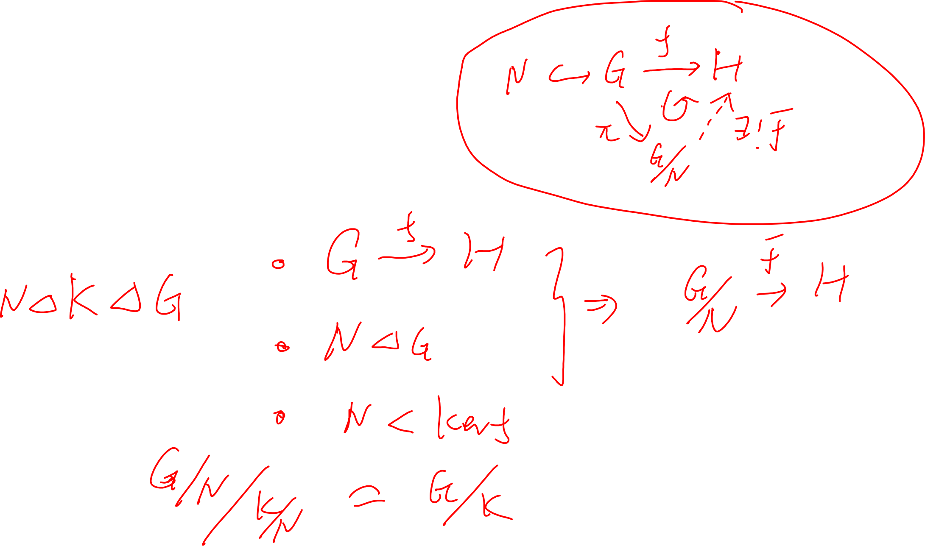
Group Theory
Homomorphism Theorems

Slide 3
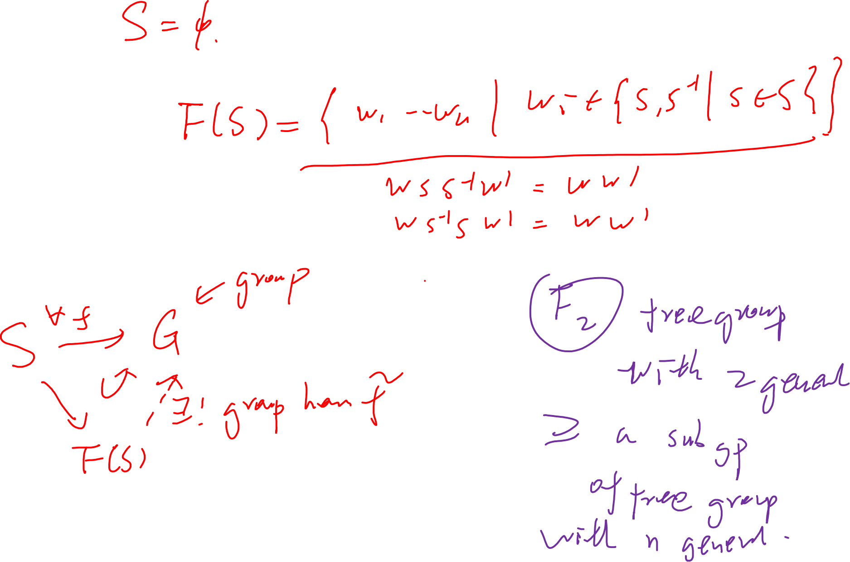
Free group
By explicit construction
By universal property

Slide 4
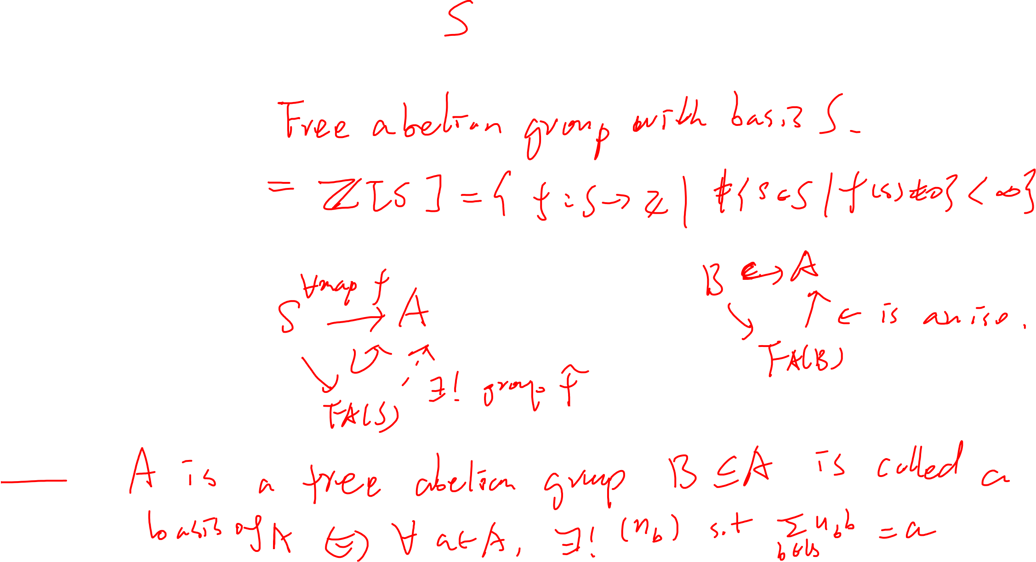
Free Abelian group
By construction
By Universal property
Basis

Slide 5
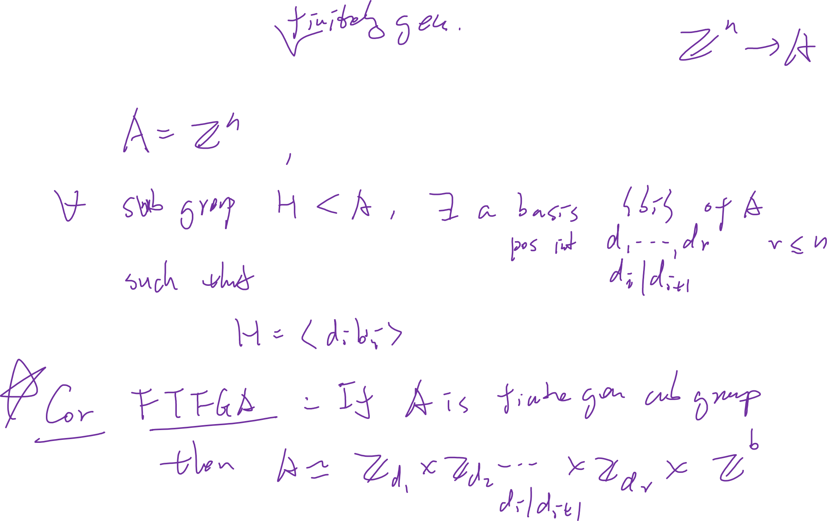
Subgroup of a free abelian group

Slide 6
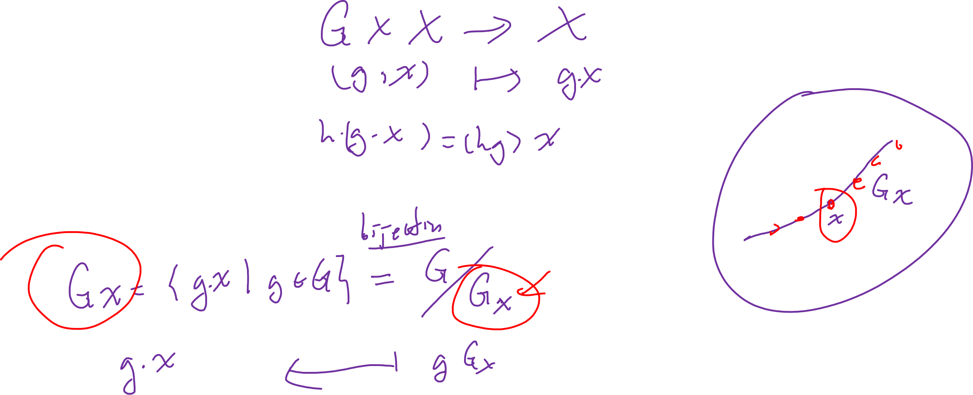
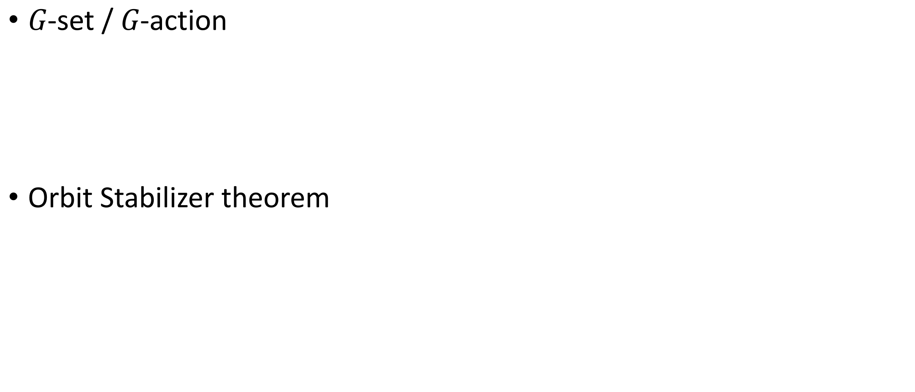
Group Theory
$G$-set / $G$-action
Orbit Stabilizer theorem

Slide 7
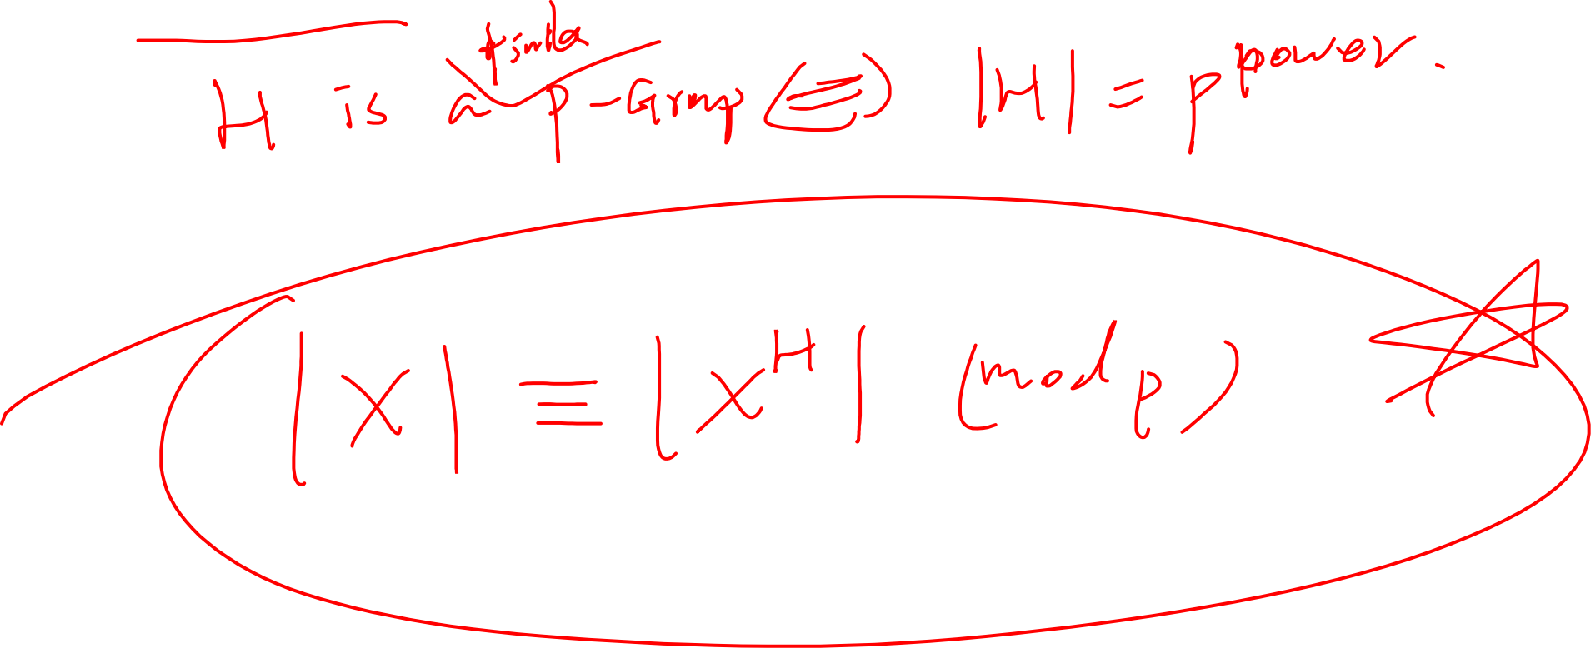
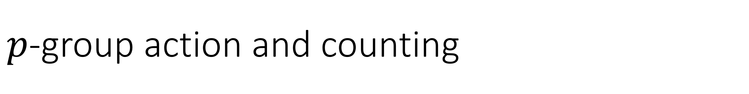
$p$-group action and counting

Slide 8
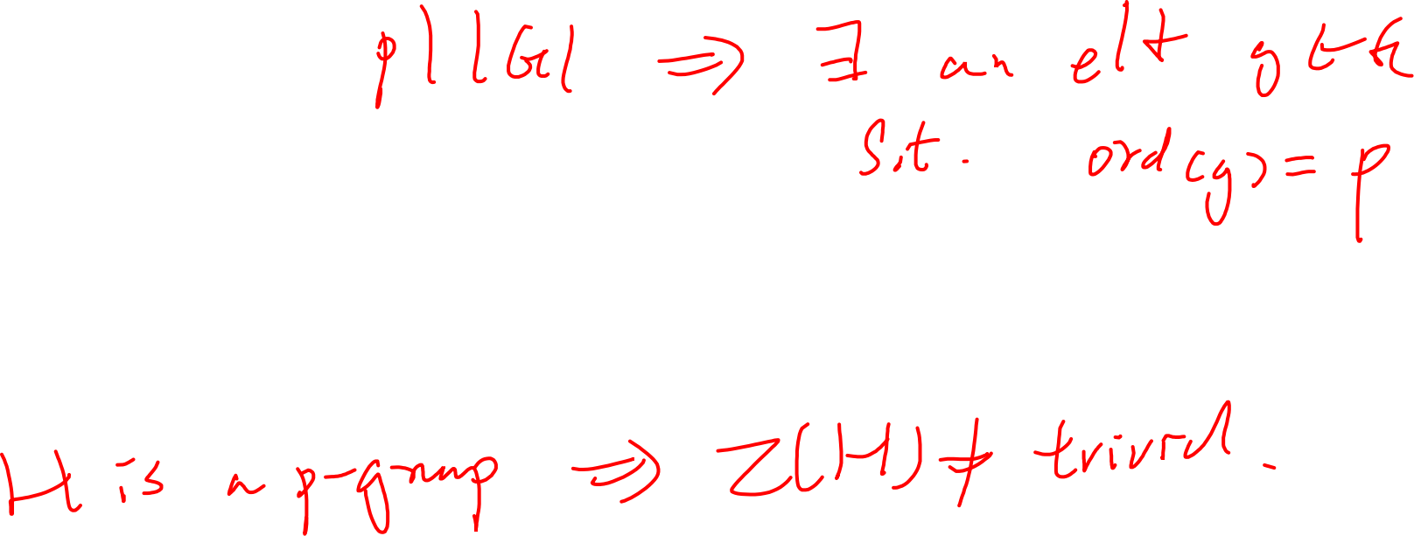

Consequences of counting equation
Cauchy’s theorem
Centre of $p$-group is non-trivial

Slide 9
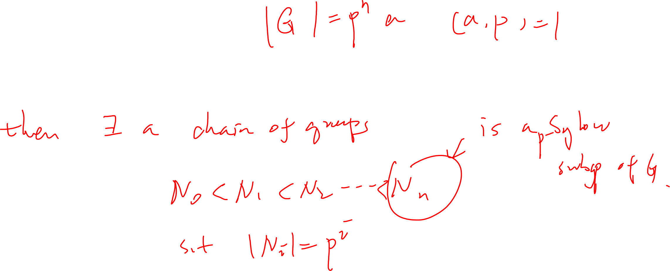
Sylow’s theorem
Existence of Sylow subgroup

Slide 10
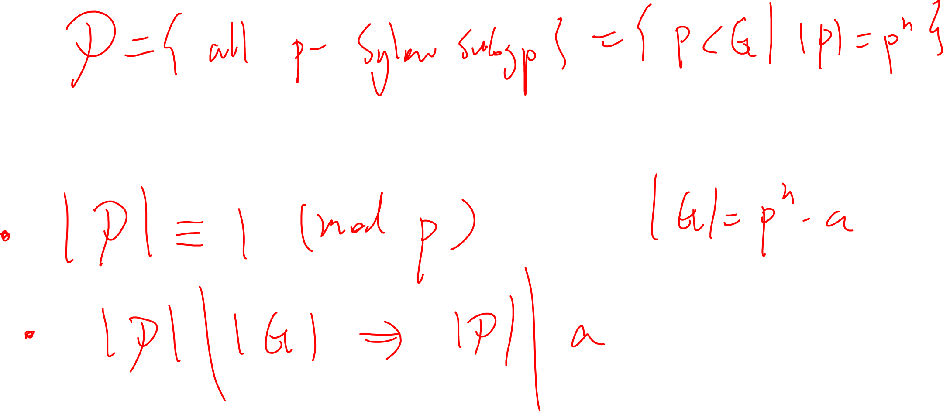
Number of Sylow subgroup

Slide 11
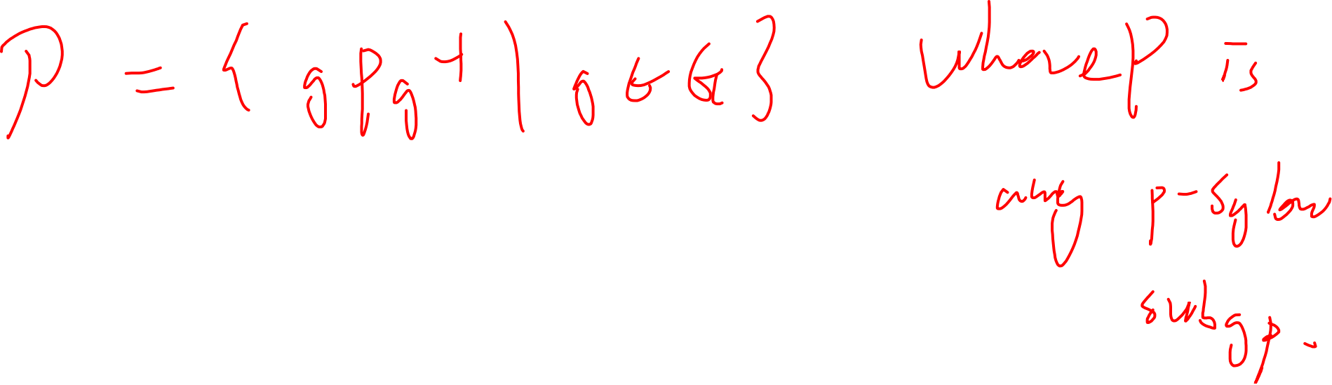
All Sylow subgroups are conjugate to each other

Slide 12
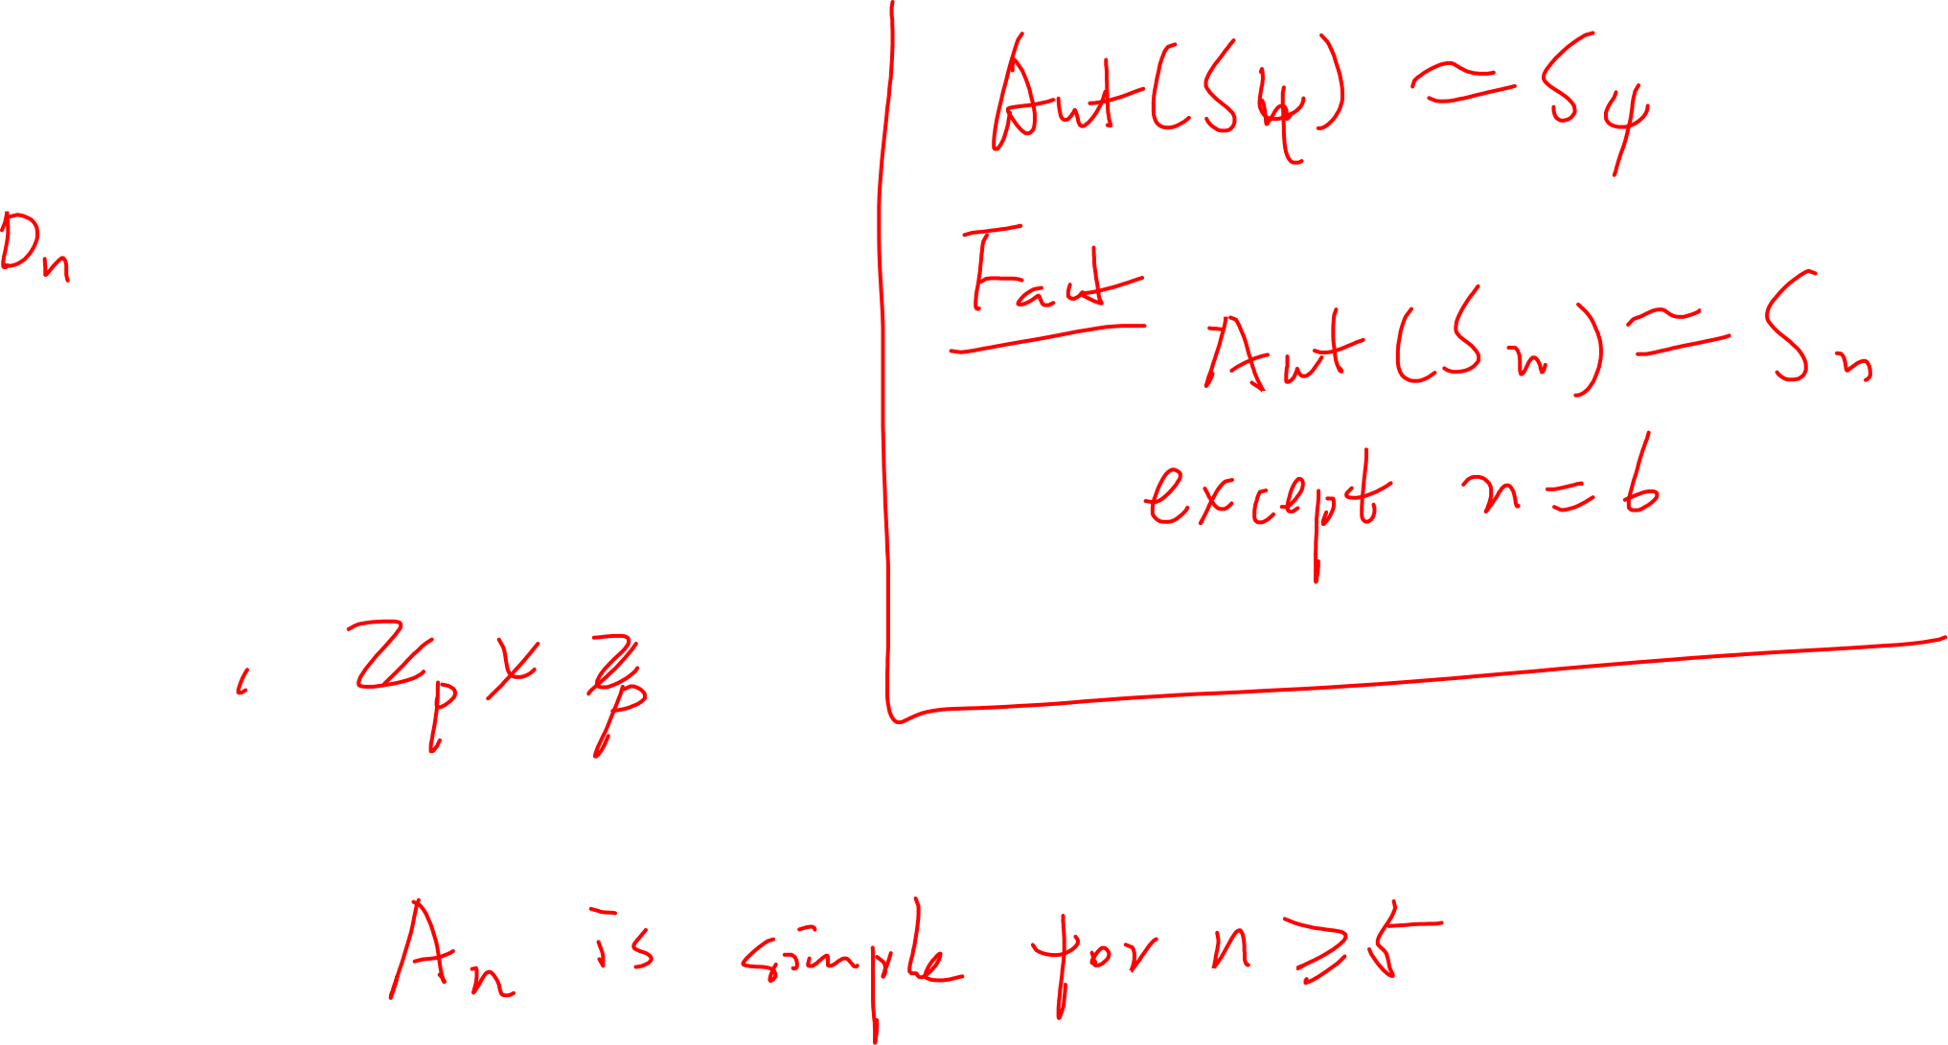

Important examples
$D_{3}=S_{3}$
$ℤ_{2}×ℤ_{2}$
$A_{n}<S_{n}$

Slide 13
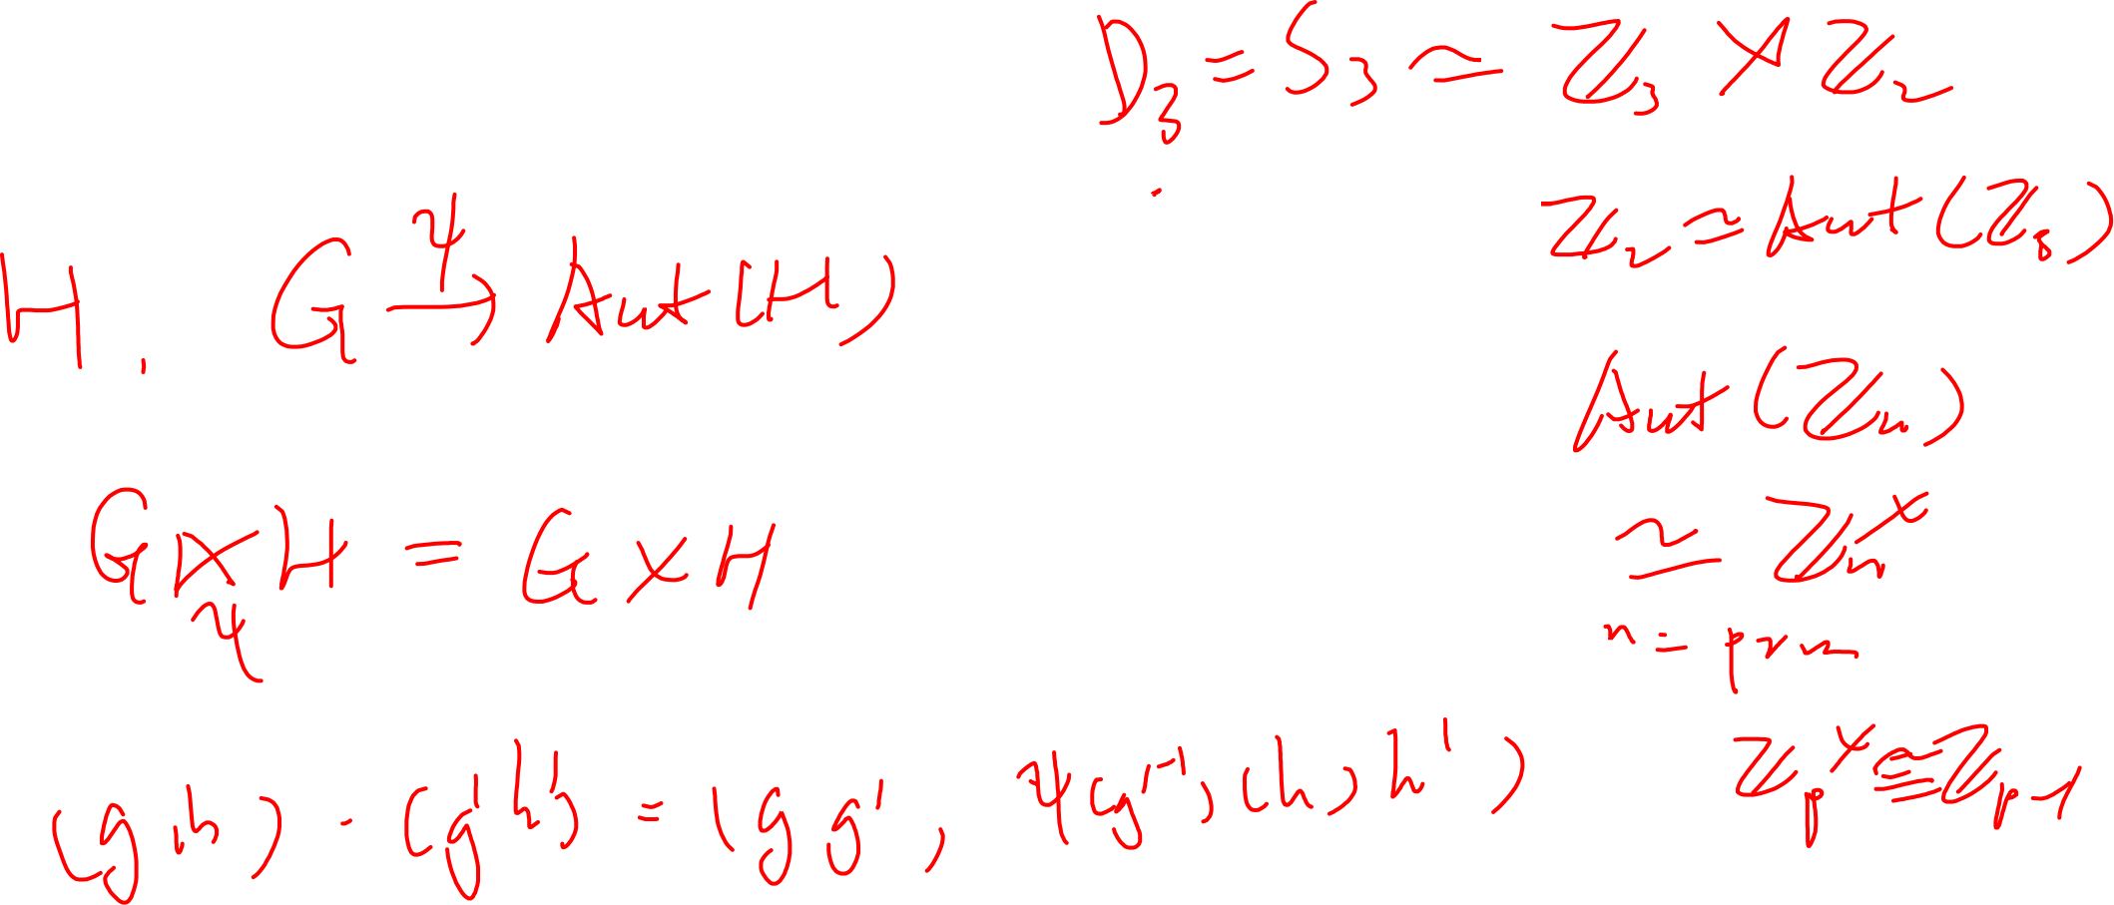
Semi-direct product

Slide 14
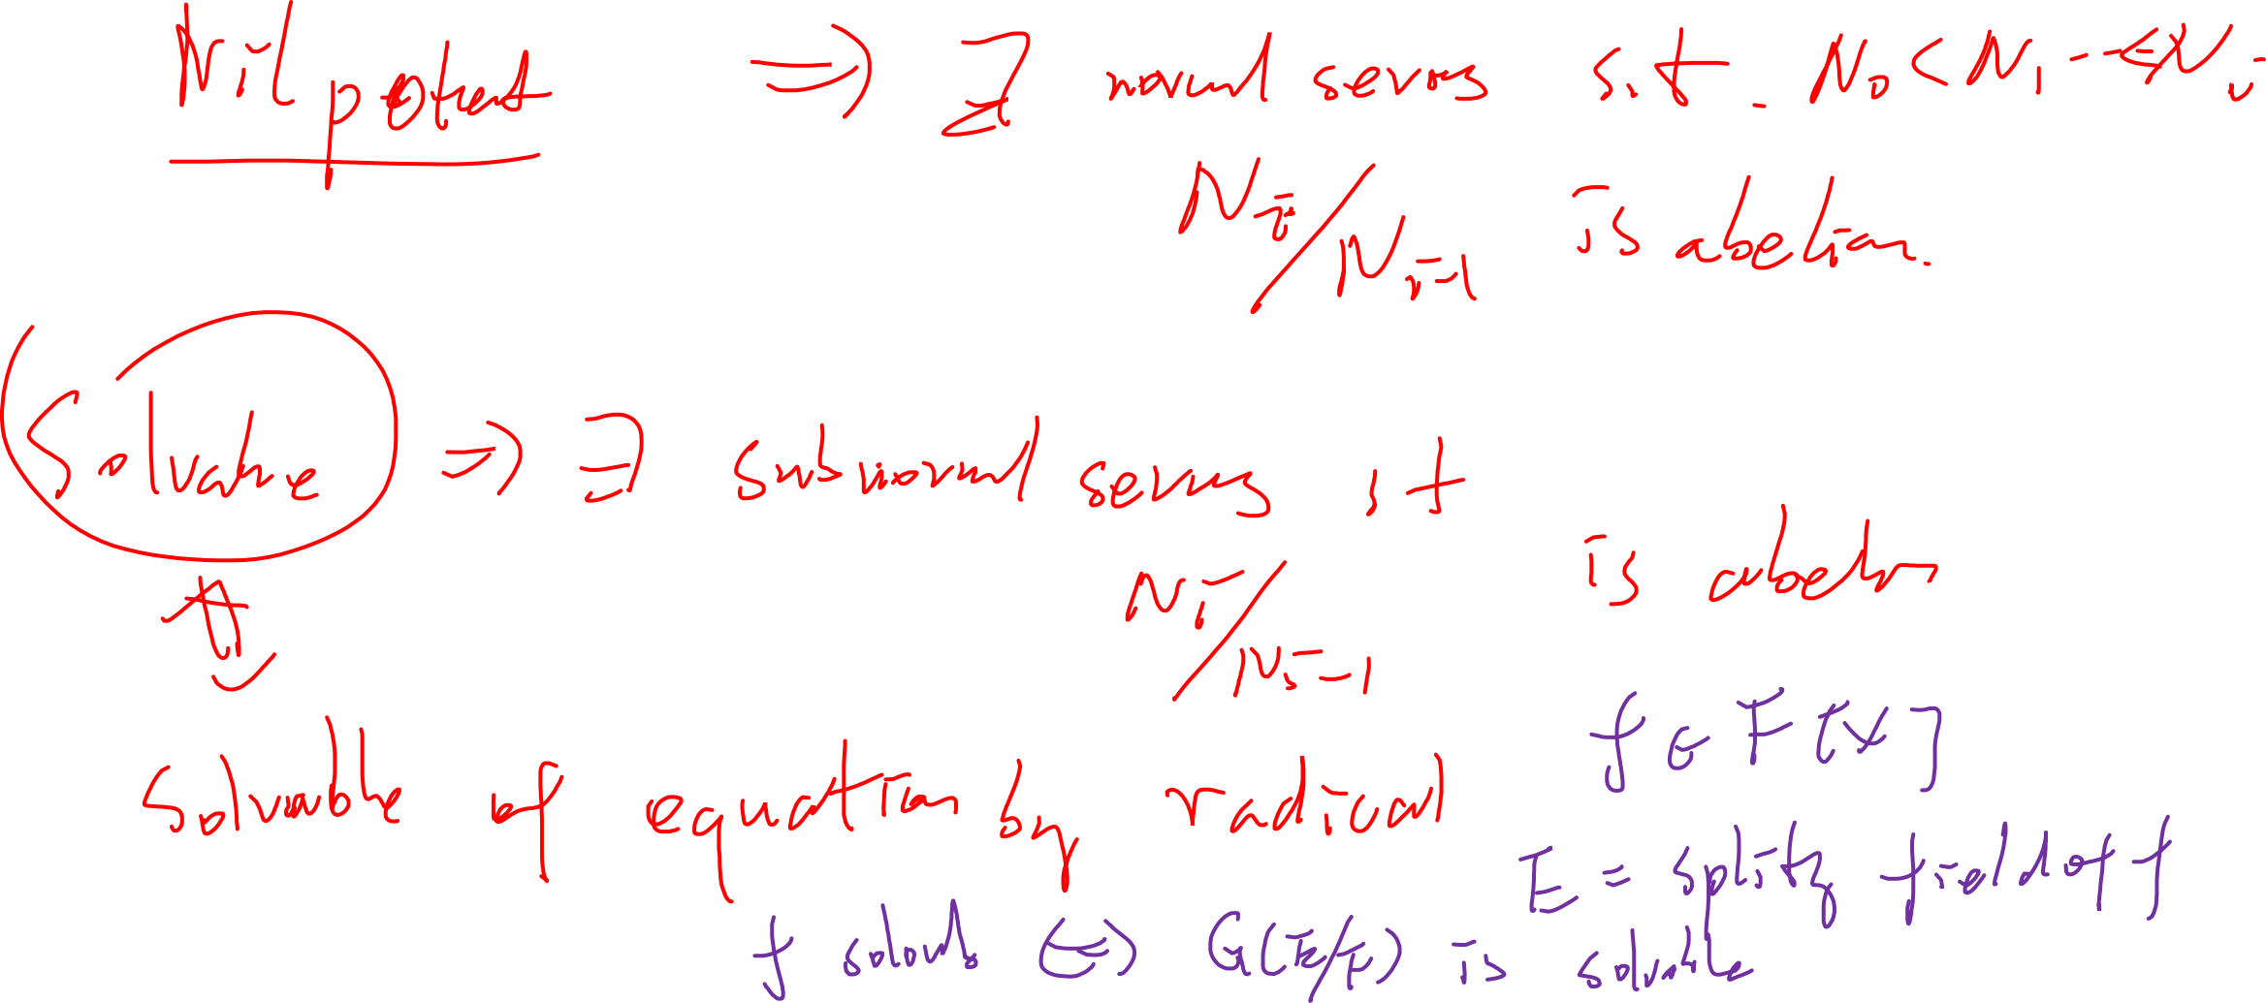
Nilpotent and Solvable groups

Slide 15
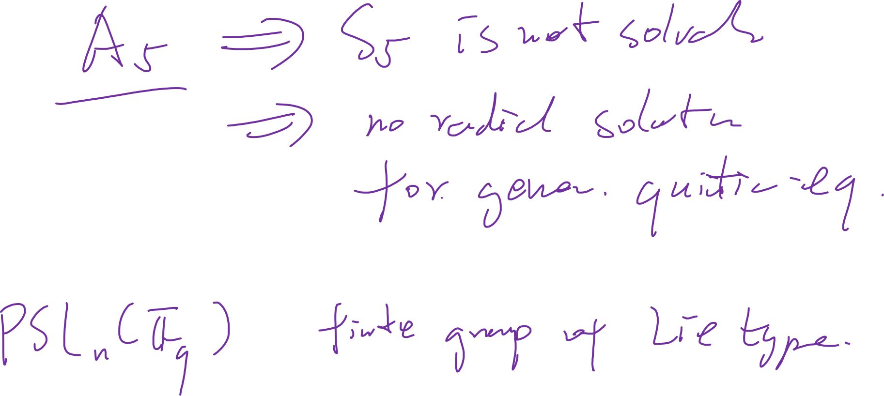
Simple groups
Examples?

Slide 16
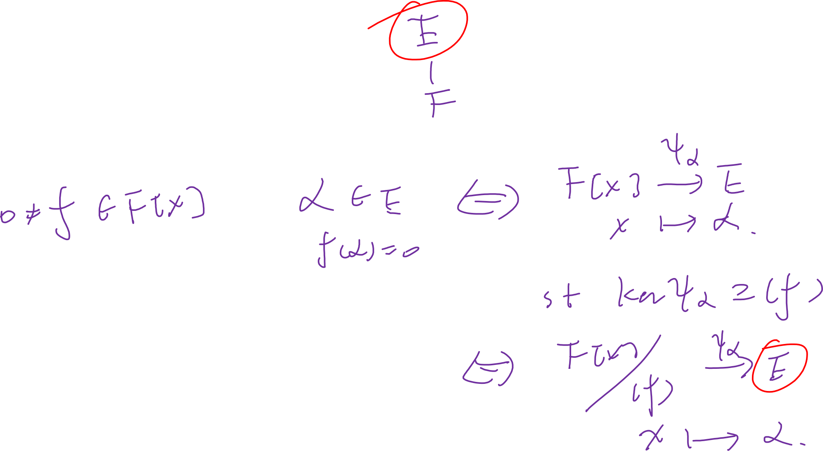
Field Theory
Solving algebraic equation

Slide 17
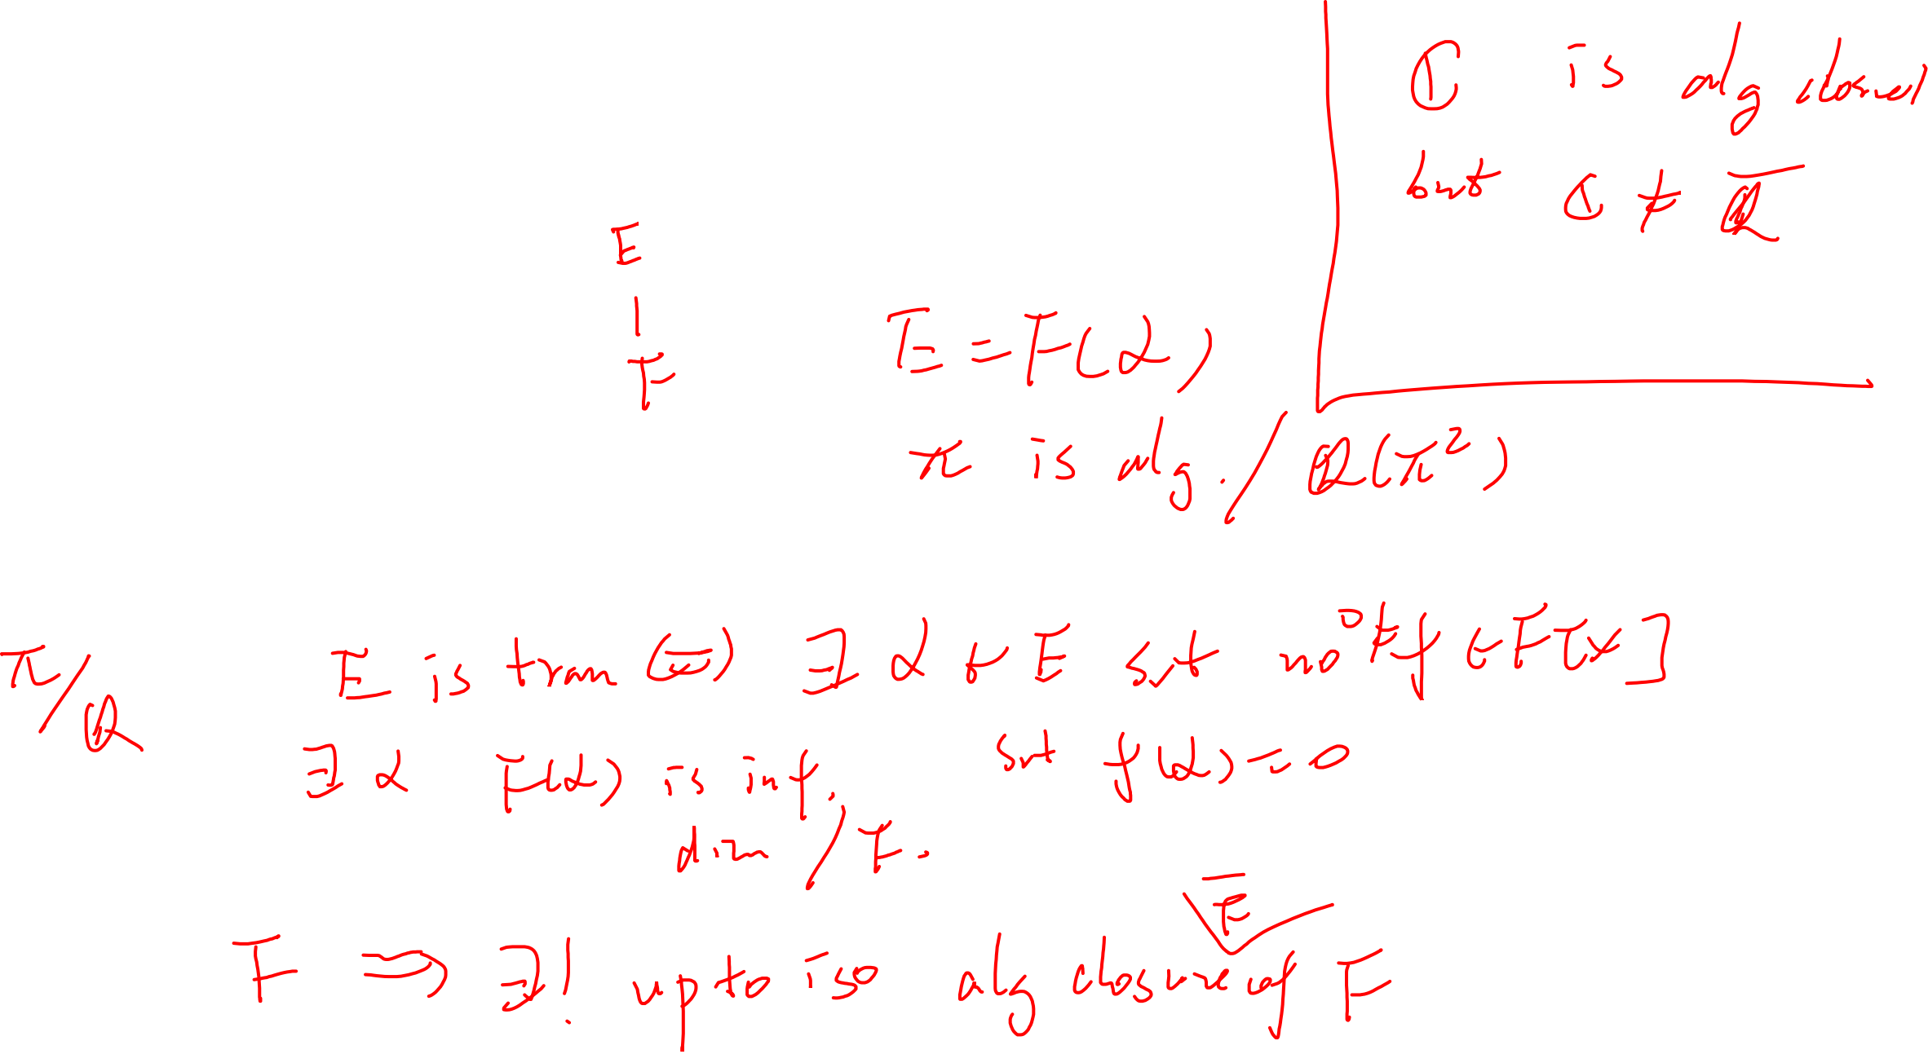
Algebraic Extension
simple extension
Transcendental extension
Algebraic closure

Slide 18
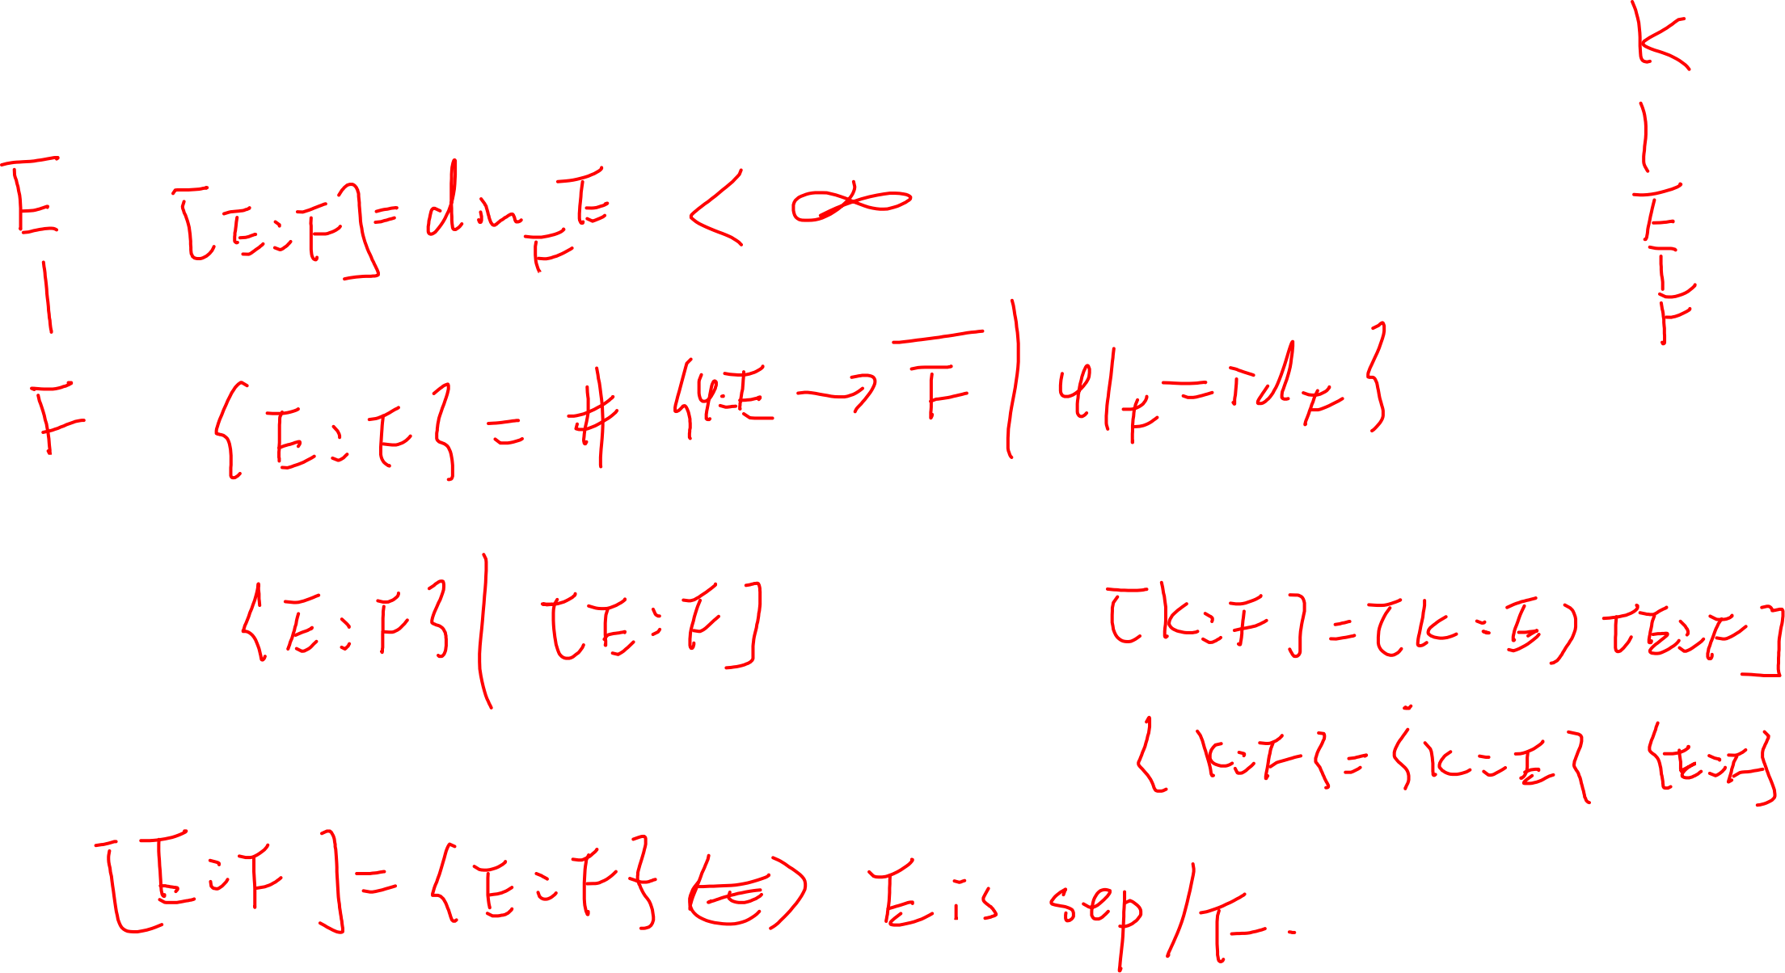
Degree and index of a finite extension

Slide 19
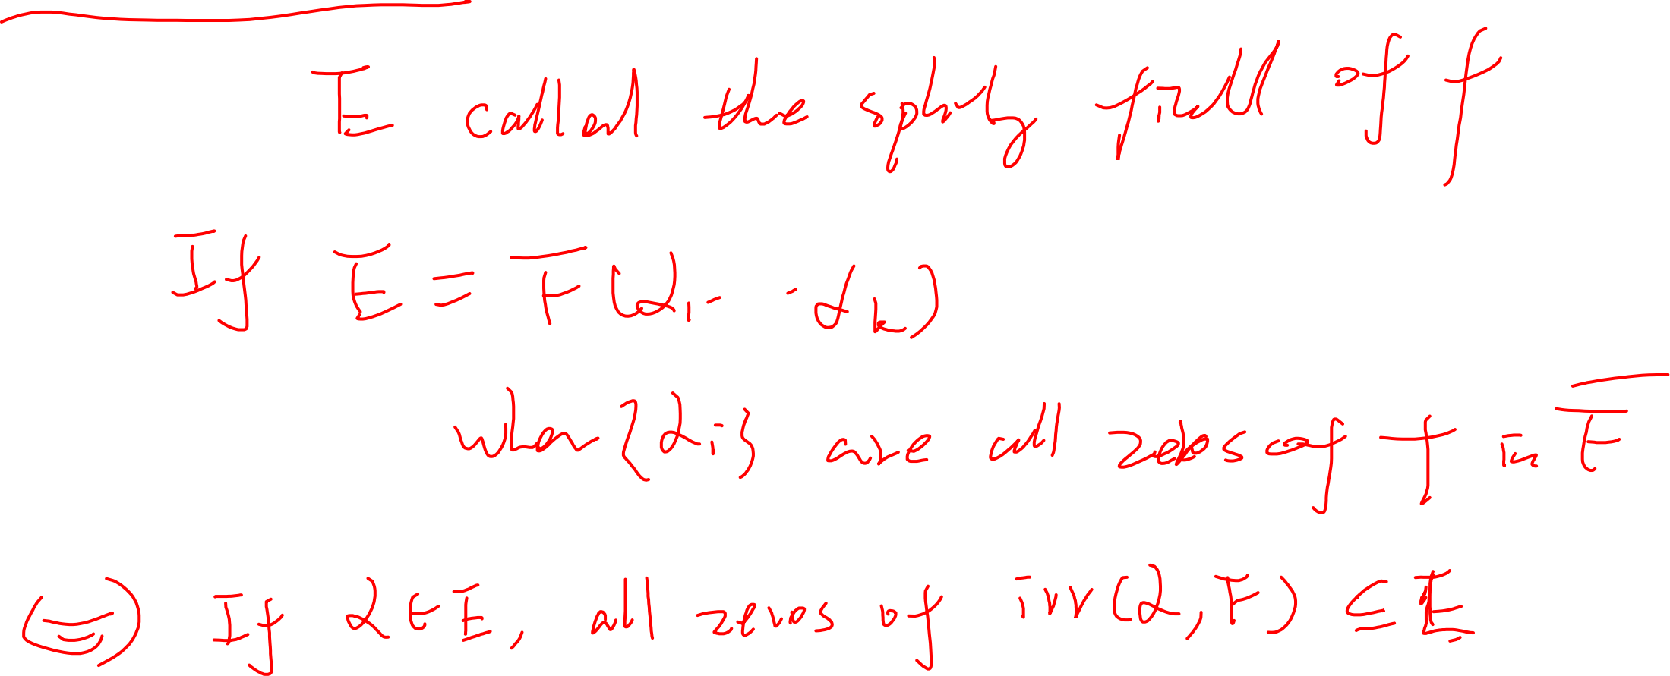
Splitting field

Slide 20
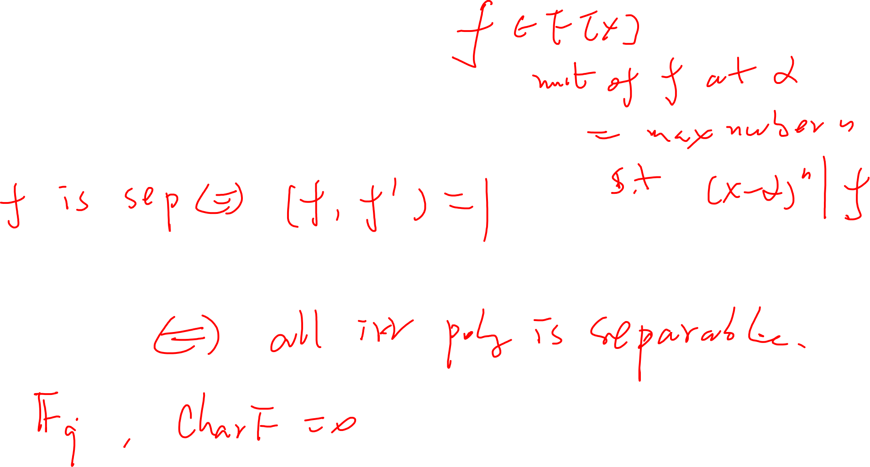
Separable extension
Derivative and separability of a polynomial
Perfect field

Slide 21
Normal/Galois Extension

Slide 22
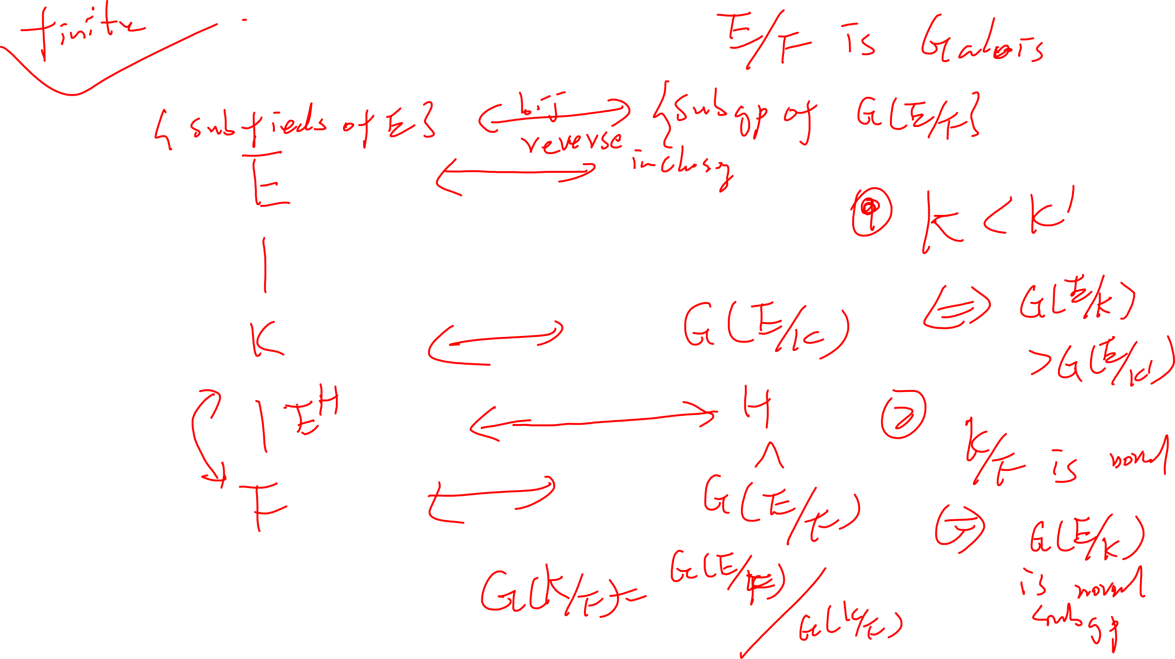
Galois correspondence

Slide 23
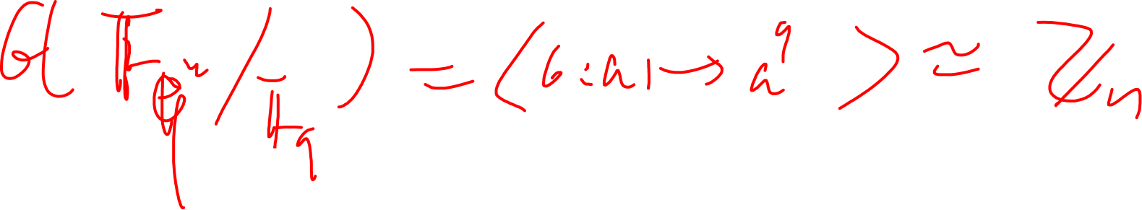
Examples
Finite fields

Slide 24
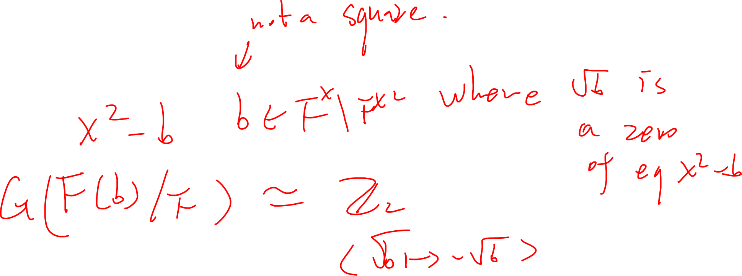
Example
Quadratic extension

Slide 25
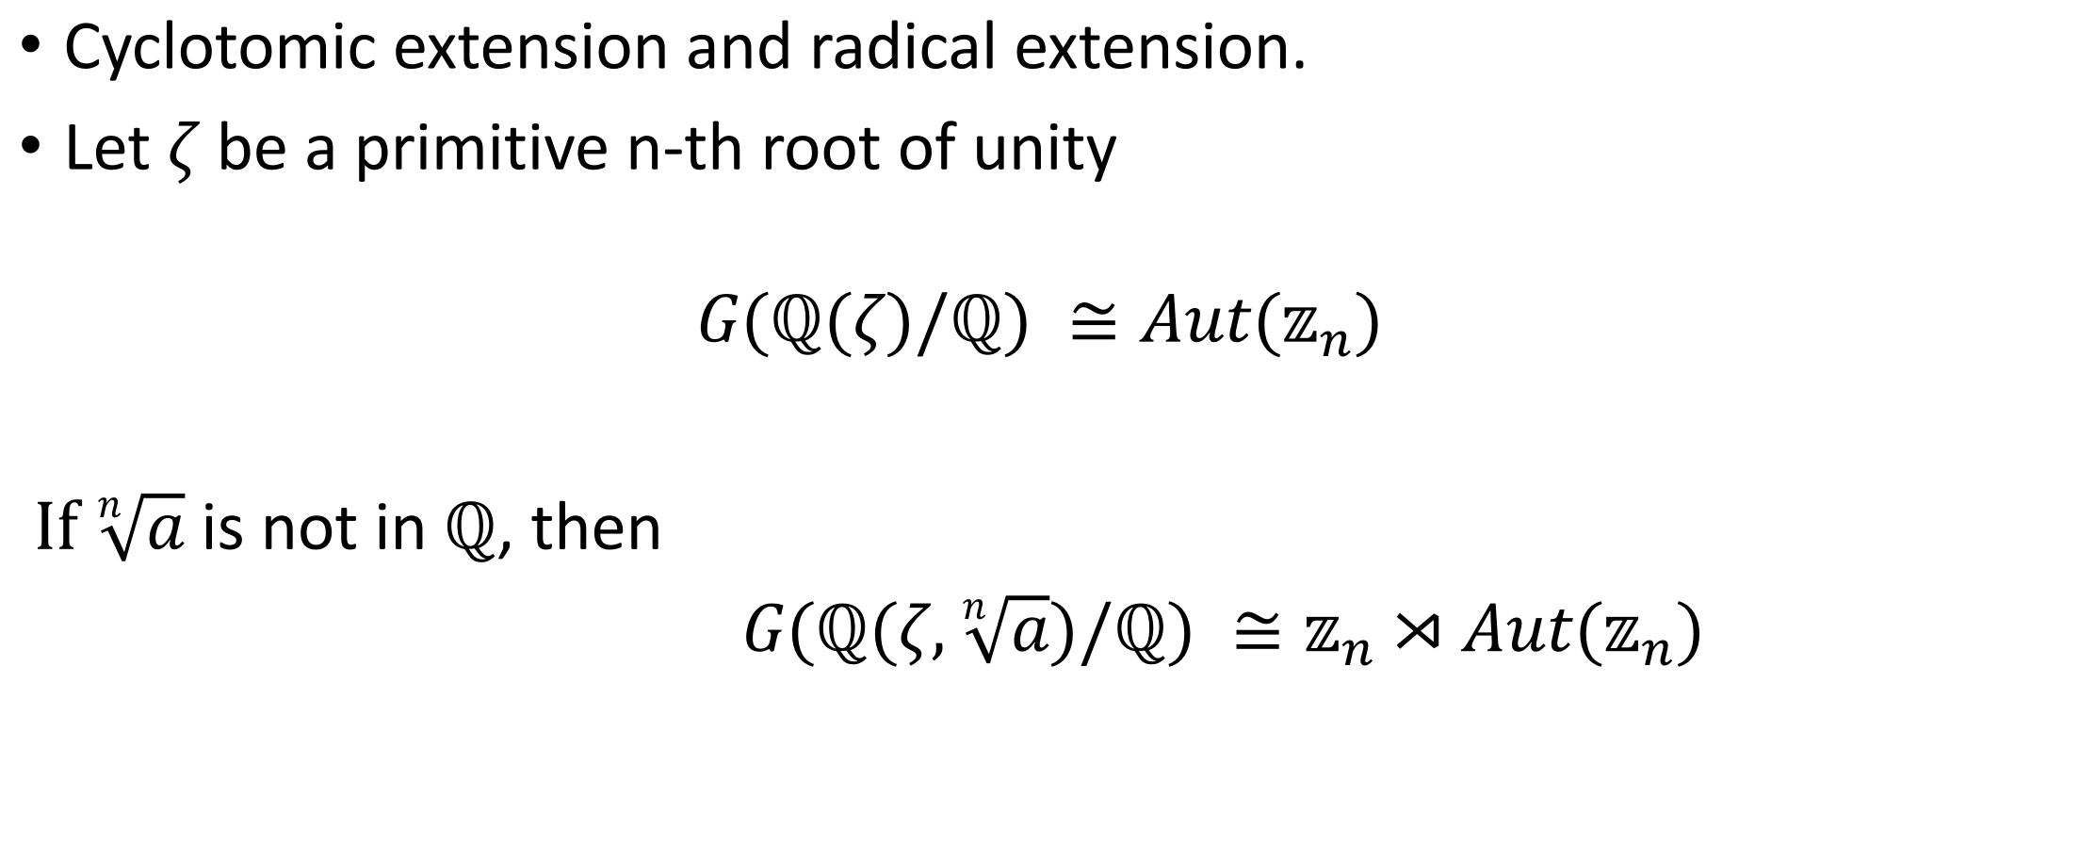
Example
Cyclotomic extension and radical extension.
Let $ζ$ be a primitive n-th root of unity
$$G(ℚ(ζ)/ℚ) ≅Aut(𝕫_{n})$$
If $\sqrt[n]{a}$ is not in $ℚ$, then
$G(ℚ(ζ,\sqrt[n]{a})/ℚ) ≅𝕫_{n}⋊Aut(𝕫_{n})$

